Slide 1
SURGICAL SAFETY & COMPLIANCE
AegisOR
AI-Powered Operating Room Compliance Platform
Real-time speech intelligence enforcing surgical protocols, closed-loop communications, and automated audit trails.

Slide 2
CLINICAL REALITY
The Cost of Communication Breakdown
70%
4,000+
30%
Root Cause of Sentinel Events
Surgical Never Events Annually
Nursing Documentation Load
Communication failures drive preventable errors.
Wrong-site incisions and retained items.
Manual charting detracts from direct patient focus.

Slide 3
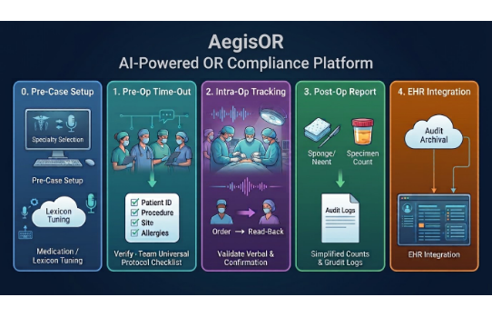

PLATFORM ARCHITECTURE
End-to-End Surgical Safety Loop
Continuous Audio Intelligence
AegisOR listens alongside the surgical team to automate mandatory documentation and mitigate human communication errors.
Pre-incision Universal Protocol checks
Real-time order read-back validation
Automated post-op EHR documentation

Slide 4
PIPELINE ARCHITECTURE
5-Stage Continuous Verification Model
00
01
02
03
04
Lexicon Tuning
Time-Out Check
Closed-Loop
Sign-Out Logs
EHR Export
Domain model priming.
Universal protocol match.
Order read-back tracking.
Needle & sponge tally.
Automated compliance sync.

Slide 5
STAGE 0
Pre-Case Setup & Lexicon Tuning
Specialty Presets
Pharmacology Injection
Acoustic Model Priming
Preloads orthopedics, laparoscopy, or cardiology terminology.
Biases speech recognition toward procedure-specific drug names.
Maximizes transcription precision amid OR ambient fan noise.

Slide 6
STAGE 1
Pre-Op Time-Out Verification
Automated Universal Protocol
Continuous listening detects mandatory safety briefings prior to initial incision.
REAL-TIME VALIDATION
Zero-Touch Checkpoints
Patient Identity & Consent
The system matches verbal assertions against EHR scheduled data without requiring manual touchscreen interaction.
Operative Site & Side Confirmation
Allergies & Prophylactic Antibiotics

Slide 7
STAGE 2
Intra-Op Closed-Loop Tracking
1. Verbal Directive Issued
2. Read-Back & Confirm
Surgeon issues a medication dosage or critical action item.
AegisOR listens for repetition and marks the safety loop closed.
"Administer 5,000 units Heparin."
"5,000 units Heparin pushed."

Slide 8


STAGE 3
Sign-Out & Operative Reporting
Count Reconciliation
Specimen Verification
Auto-Generated Draft
Verbal needle, sponge, and tool tallies captured automatically.
Tissue labeling and margin descriptions confirmed verbally.
Synthesizes procedure timestamps into an instant audit report.

Slide 9
STAGE 4
Audit Archival & EHR Integration
EHR Interoperability
Immutable Audit Trail
Safety Analytics
Syncs structured events directly to Epic, Cerner, and Meditech via FHIR APIs.
Generates time-stamped logs for clinical compliance and hospital risk defense.
Aggregates hospital-wide compliance dashboards to target quality training.

Slide 10
TRANSFORMATION
Traditional OR vs. AegisOR
Manual OR Workflows
AegisOR Intelligent System
• Paper-based time-outs prone to habituation
• Continuous hands-free checklist validation
• Verbal orders unrecorded during emergencies
• Automatic read-back confirmation logging
• Heavy post-case administrative documentation
• Automated operative summaries in seconds
• Difficult retrospective malpractice audits
• Precise, timestamped objective audit trails

Slide 11
MEASURABLE OUTCOMES
Clinical & Operational Return
100%
-45m
Leading
Protocol Adherence
Documentation Time
Acoustic Accuracy
Zero missed time-out safety checkpoints.
Saved per surgical team shift.
Domain-tuned medical transcription.

Slide 12

AegisOR
Safeguarding surgical teams through real-time voice intelligence.
QUESTIONS & DISCUSSION

